Slide 1
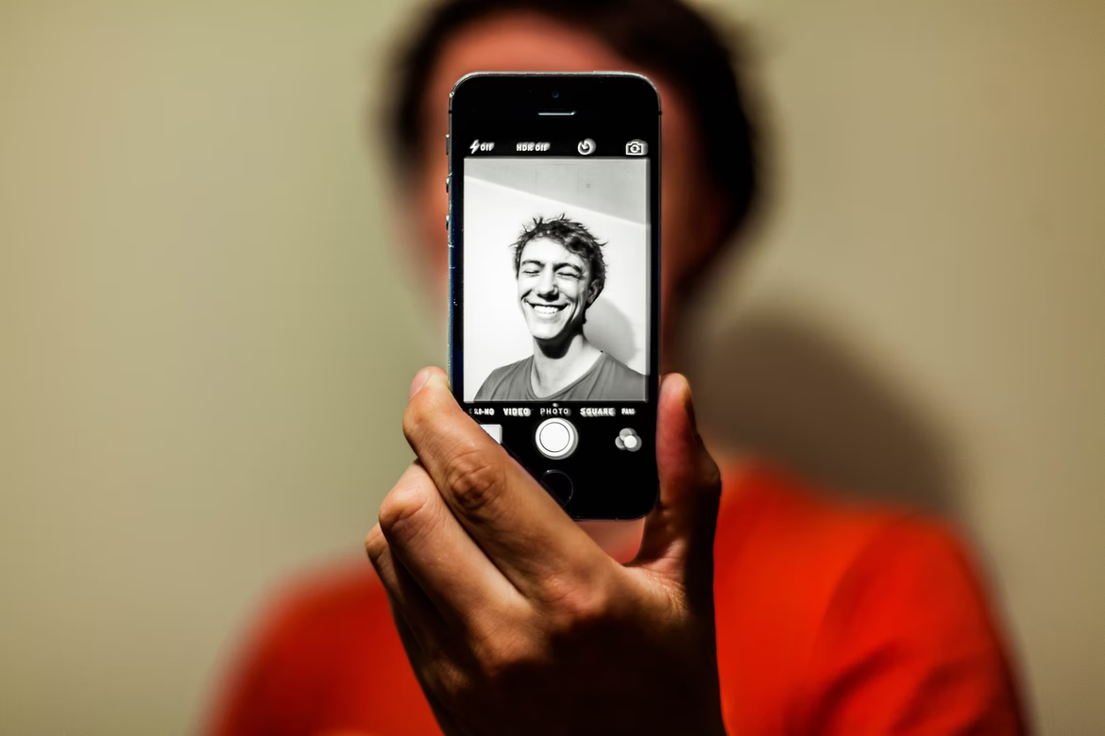
Take a Snap
Snap
Creating the Best Version of You

Slide 2
Creating the Best Version of You
Working with Self-Portraits
From the book of Photo Therapy Techniques
Judy Weiser
Notes:
Opening slide. Make a soft music list of 15-20 minutes.
You will play it before the workshop starts, when participants entering the room.

Slide 3
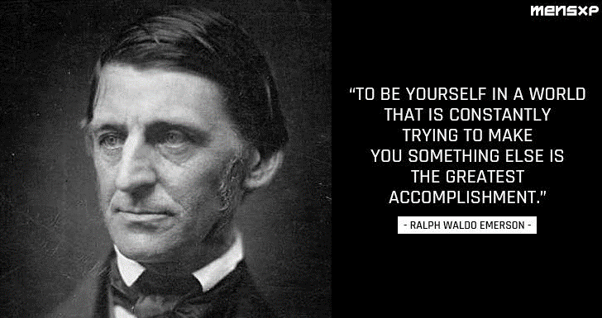
Notes:
Opening slide. Make a soft music list of 15-20 minutes.
You will play it before the workshop starts, when participants entering the room.

Slide 4
Pause II
Notes:
Opening slide. Make a soft music list of 15-20 minutes.
You will play it before the workshop starts, when participants entering the room.

Slide 5
Selfie Snap Shot VDO
Put VDO here
Notes:
Opening slide. Make a soft music list of 15-20 minutes.
You will play it before the workshop starts, when participants entering the room.

Slide 6
Take a Snap
Snap
Notes:
Opening slide. Make a soft music list of 15-20 minutes.
You will play it before the workshop starts, when participants entering the room.

Slide 7
Which Photo You Like the Most ?
Why do you like this photo ?
What did you feel at that moment ?
Why did you choose to act like this ?
What did it mean for you ?
Write it down…..
Notes:
Opening slide. Make a soft music list of 15-20 minutes.
You will play it before the workshop starts, when participants entering the room.

Slide 8
Finding the one with number you choose
What do you like/dislike in this photo ?
What did you feel at that moment ?
Why did you choose to act like this ?
What did it mean for you ?
Write it down…..
Notes:
Opening slide. Make a soft music list of 15-20 minutes.
You will play it before the workshop starts, when participants entering the room.

Slide 9
Look into your normal “Selfie” Mode
What do you like/dislike in this photo ?
What did you feel at that moment ?
Why did you choose to act like this ?
What did it mean for you ?
Write it down…..
Notes:
Opening slide. Make a soft music list of 15-20 minutes.
You will play it before the workshop starts, when participants entering the room.

Slide 10
Sharing in your group
Listening to others about your photo first
Then, Sharing what you found from your photo
Notes:
Opening slide. Make a soft music list of 15-20 minutes.
You will play it before the workshop starts, when participants entering the room.

Slide 11
…The Theory…
Notes:
Opening slide. Make a soft music list of 15-20 minutes.
You will play it before the workshop starts, when participants entering the room.

Slide 12
Therapy with self-portrait images is based on what the client thinks of him- or herself as presented in the photo regardless of image’s effects on others.
When you see other people image, you would first encounter your own reactions to it, how it makes sense to you, how it make you feel, and what you think was happening for the client for him/her to have chose to post this way.
You would have to put your ideas aside to also explore how the image made sense to him/her both during the photo taking process and upon later reflection.
Notes:
Opening slide. Make a soft music list of 15-20 minutes.
You will play it before the workshop starts, when participants entering the room.

Slide 13
The surface contents of the photograph are only our beginning point, and our immediate assumptions about it are often incorrect because they are based more on our own reactions than the client’s intention.
Readers might want to consider what questions would be helpful in “working” this self-portrait with the client.
Suggested questions can be How I would describe the person in this photo to someone unable to see it ? Three feelings stimulated in me by seeing this photo ? What would I like to tell this photo ? What would this photo like me to know ?
Notes:
Opening slide. Make a soft music list of 15-20 minutes.
You will play it before the workshop starts, when participants entering the room.

Slide 14
Sharing in your group
One more time with different conversation
By using suggested questions from the book
Notes:
Opening slide. Make a soft music list of 15-20 minutes.
You will play it before the workshop starts, when participants entering the room.

Slide 15
Which photo represent
your best version for 2022
Notes:
Opening slide. Make a soft music list of 15-20 minutes.
You will play it before the workshop starts, when participants entering the room.

Slide 16
Before End
Notes:
Opening slide. Make a soft music list of 15-20 minutes.
You will play it before the workshop starts, when participants entering the room.

Slide 17
Did your image change
once you found out
you had to give
your special portrait
to someone ?
Judy Weiser
Notes:
Opening slide. Make a soft music list of 15-20 minutes.
You will play it before the workshop starts, when participants entering the room.

Slide 18

“There is no reality except the one contained within us. That is why so many people live such an unreal life. They take the images outside of them for reality and never allow the world within to assert itself.”
Notes:
Opening slide. Make a soft music list of 15-20 minutes.
You will play it before the workshop starts, when participants entering the room.

